Slide 1
Analysis of Bike Data
By Shrushti Patel

Slide 2
Objective: How European Bicycle Company can grow profit by 10% within 2 years by adding more features to their products and making more customers?
Data Source:
The Data was extracted from Kaggle for analysis and it contains bike data from Year 2011 to 2016.

Slide 3
Understanding of Data Attributes:
LABEL | DESCRIPTION
Date | Date of product Sold
Day | Day when product sold
Month | Month for selling product
Year | Selling Year
Customer Age | Age of the Customer
Age Group | Age group of the Customer
Customer Gender | Gender of Customer
Country | Name of the country the customer ordered the product
State | State of the customer from where they order the product
Product Category | The name of the category on which the product belongs to
Sub Category | Sub Category of the product
Product | Product Name
Order Quantity | The number of product ordered by customers
Unit Cost | The basic cost of the product
Unit Price | The price of the product
Profit | Profit gained from that product
Cost | Cost of the product
Revenue | Income gained from the product

Slide 4
Analysis Pipeline-The OSEMN Approach:
Obtain the Data: The dataset is extracted from Excel file
Scrubbing/ Cleaning the Data: Initial data exploration and preparation for analysis
Exploring/Visualizing Our Data: Basic EDA to understand the data Modeling the Data
Interpreting the Results

Slide 5
Cleaning And Shaping Data:
No Null Values
Removed duplicated Values
Unique Values For Columns:
Years 2011 2012 2013 2014 2015 2016
Age Group Youth (<25) Youth Adults (25-34)
Adults (35-64) Seniors (64+)
Customer Gender M F
Country Name Canada Australia United States Germany
France United Kingdom
No. of States 53
Product Category Accessories Bike Clothing
No. of Subcategory 17
No. of Products 130

Slide 6
Areas of Exploration:
Overall Revenue by Years and Countries
Monthly Revenues for all years
Proportion of Revenues by Countries
The most Selling Products
Comparing prices and No. of Orders by subcategories
We will See which Subcategory brings more profit and which Subcategory has more profit margins.
Correlation between Order Quantity with Unit Price, Unit Cost, Profits, Revenue, Profit Margin and Cost.

Slide 7
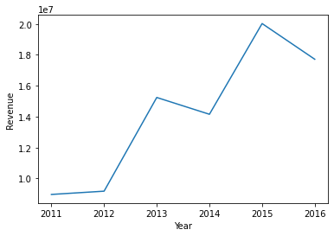
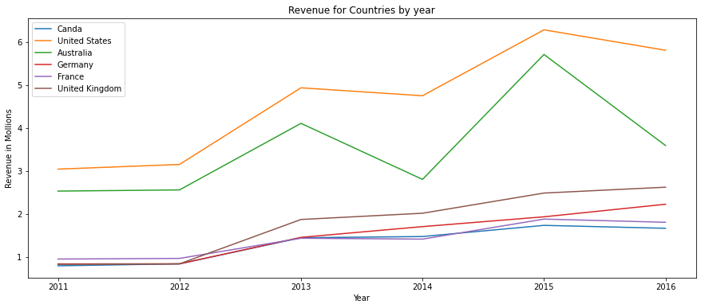
Exploring And Visualizing Our Data: Let’s see overall revenue by years for all countries
If we see over all revenues for each country by years, we can see that the revenues has increase for countries Canada, United Kingdom, Germany and France. There is more fluctuations for United States and Australia.
The below chart shows the fluctuations in revenues, we can see that there was a pick in 2013 and fall in 2014, again pick in 2015 and reducing in 2016.

Slide 8
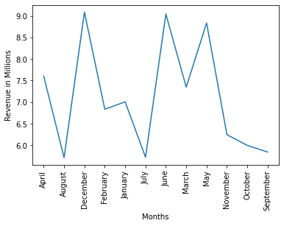
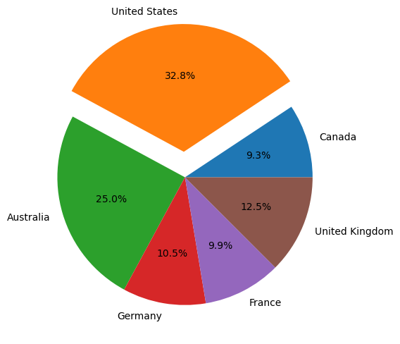
Let's See for Which months people like to buy more, and which countries brings more the highest revenue
The below chart shows that in the month of December, People has ordered the highest followed by June and November.
United States brings the highest revenue (32.8%) followed by Australia (25.0%).

Slide 9
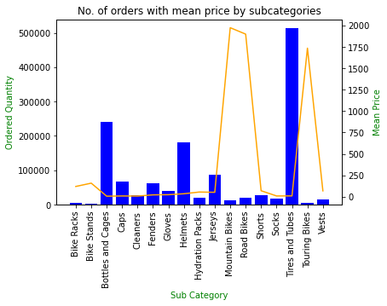
Let’s See The No. of orders by sub categories and mean prices The below chart explains the no. of quantity ordered by subcategory comparing with the mean price for subcategory, we can see that Tires and Tubes has the highest selling and mean price for that product is less and Mountain Bike’s mean price is high, but no. of orders are less.

Slide 10
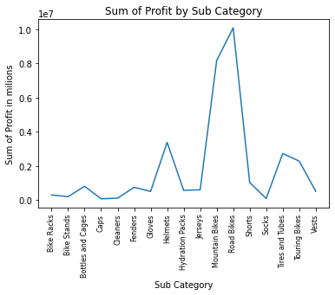
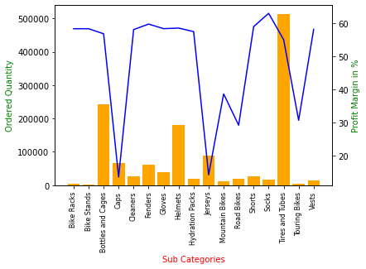
Let’s See Which Sub Category brings more profit and Which Sub Category has the highest profit margins.
The chart explains ordered quantity and profit margin for subcategory. From the below graph we can say that Tires and Tubes has the highest selling and good profit margin(54%). Bike racks, Bike Stands, Cleaners, Fenders, Gloves, Hydration Packs, Shorts, Socks, Vests has profit margins between 55% to 60% but selling of these products are very less.
The Chart shows that Road Bikes brings the highest profit followed by Mountain Bikes and Caps brings the lowest profit.

Slide 11
Conclusion
From our analysis We can conclude that for countries United States Brings the highest revenues followed by Australia, but United States and Australia have more fluctuations in revenues year by year. We need to focus for these two countries sales on how we can make revenue chart up every year to get more profits.
If we see revenues by months for all years, November, December and June months has got the highest revenues. As we know December is a Christmas month, so people like to buy gifts in these months and June is a summertime for most of the countries people like go out and like to order more.
As we saw when the prices are high for the products people buy less and when the prices are low people orders more, we need to see which product gives us more profit and we need to focus on selling those products more.
From our analysis we also saw that Bike Racks, Bike Stands, Cleaners, Fenders, Gloves, Hydration Packs, Shorts, Socks, Vests have the highest profit margins but less selling. We need to focus on increasing sells for these products to get more profits.

